Slide 1
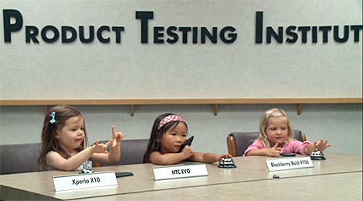

Testing - 1
Notes:
Image of testing at Sony Ericsson’s Product Testing Institute, from http://www.ft.com/cms/s/0/ace61e6a-eb85-11df-bbb5-00144feab49a.html#axzz3HNrMABai

Slide 2
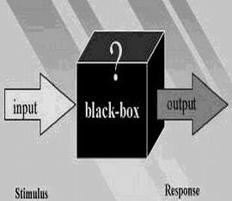
A little terminology you’re surely familiar with…
Black Box
White Box
Integration
Acceptance
Regression
Notes:
Black box testing image from http://tvtropes.org/pmwiki/pmwiki.php/Main/BlackBox

Slide 3
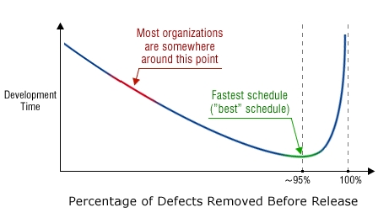
Code Reviews
“Inspection is reading the source code. Inspection can find errors no other methods can and is the most efficient testing practice.”
-Philips
Notes:
Philips is maybe a bit to excited about code reviews but they are a good idea
Image from http://www.parasoft.com/products/article.jsp?articleId=2769

Slide 4
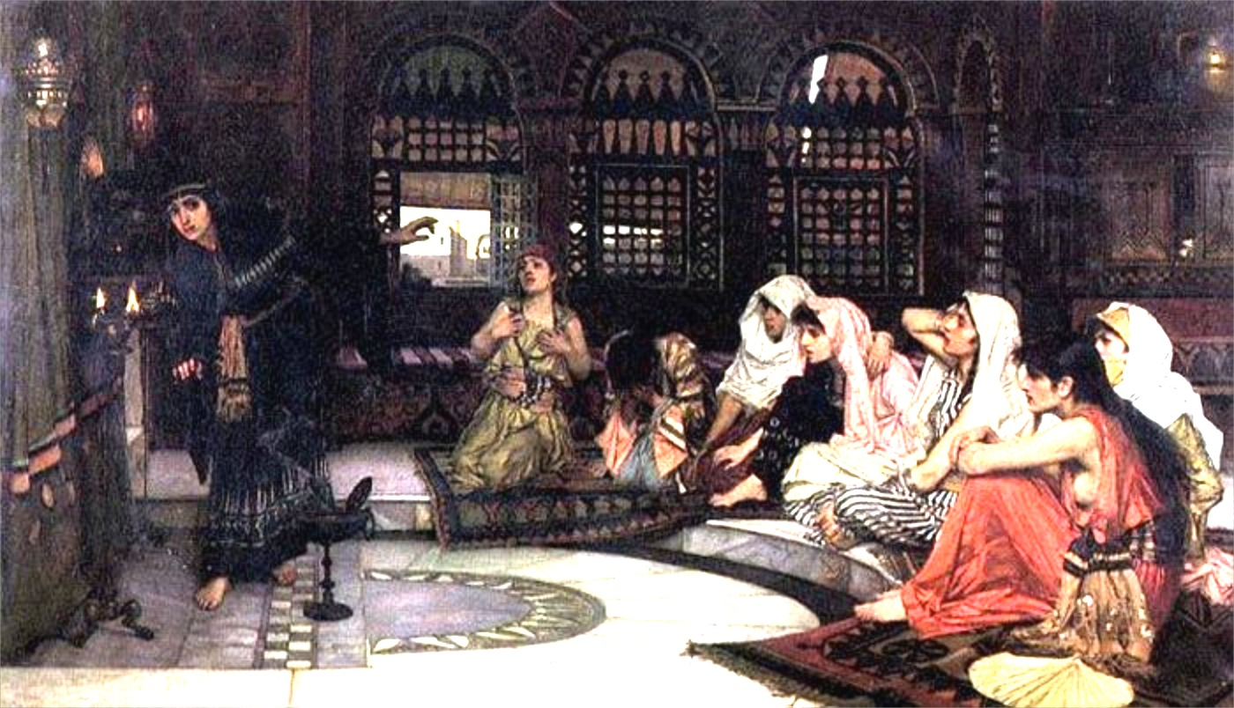
Oracle Issue
“How do you calculate the answer that only the world’s most powerful supercomputer can produce?”
Notes:
Figure out creative ways, build tools
Image from http://en.wikipedia.org/wiki/Oracle is John William Waterhouse’s painting, “Consulting the Oracle.”

Slide 5
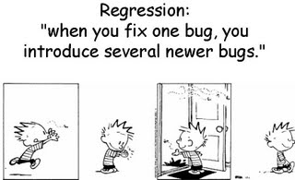
Death Spiral
Interaction Between Technical Debt and Bugs
Bug fixes introduce bugs
Can kill entire teams
We’ll have a reading on this, coming up!
Basically, things that are harder because we ignore the need to redesign.
Notes:
Image from http://www.softwaretestinghelp.com/regression-testing-tools-and-methods/

Slide 6
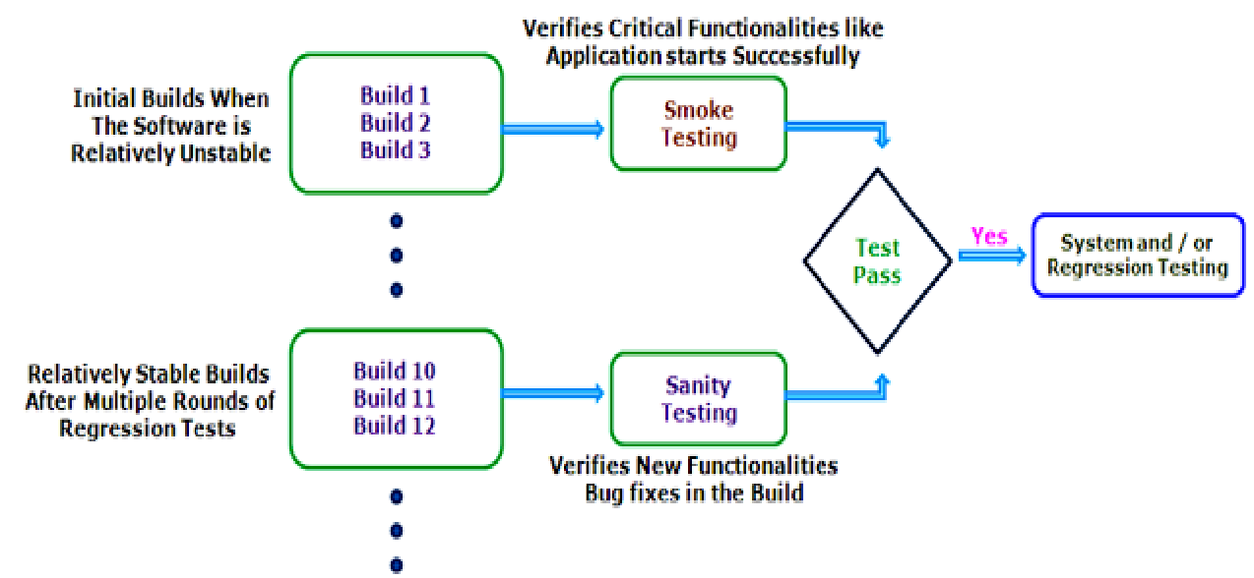
Test at the End
What to test!?
Key question at the end – “Does it crash”?
Notes:
Image from http://qalearn.blogspot.com/2013/04/smoke-testing-vs-sanity-testing.html

Slide 7
Ensure Quality Throughout
Untested code can be worse than nothing
Reviews, Unit Tests, and even methodical developer testing all play a role
Writing tools so you’re not coding blind – remember that testing can be more than 50% of your development time
Multiple test passes (but don’t use your testers as guinea pigs)

Slide 8
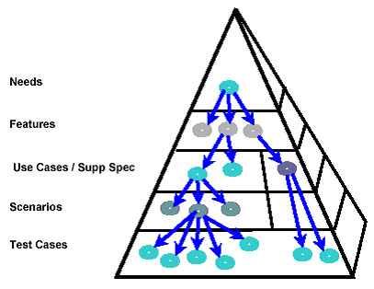
Mapping requirements to tests
Not all the testing you need
But you should do this
Notes:
Image of the mapping, from https://www.ibm.com/developerworks/rational/library/04/r-3217/

Slide 9

Different Levels of Tester Sophistication
Manual testers
Test leads
At Microsoft, testers used to be paid less than developers. Now they are paid the same.
Notes:
Image of team lead, integration and test of vehicle avionics and software, from http://www.nasa.gov/exploration/systems/sls/i-am-building-sls-hoffman.html#.VE68_L7sevs

Slide 10

Do you launch your product with known bugs?
Some of the usual suspects:
My answer always was “Yes.”
Notes:
Known bugs in the ThinkFast game, from http://tln.lib.mi.us/searchpath/help/help4.html

Slide 11
How would you TEST this? What tools would you build?
Imagine you’re working with a company that’s building a deployment process. You’ve got several “services” each of which maintains content. The deployment consists of 3 steps:
Prepare
Deploy
Rollback (maybe)
Managed by a “Deployment Manager” (DM) service. Both the services and the DM are under development. The final deployment can’t be tested unless every service has correctly deployed.
Look familiar?

Slide 12
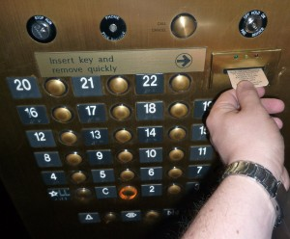
Don’t forget about the -ilities
Software architects focus on:
Performance
Availability
Usability
Security
Interoperability
Testability
Maintainability
Notes:
Example of bad usability, from http://blog.alexbowyer.com/2009/06/an-example-of-bad-usability-2/

Slide 13
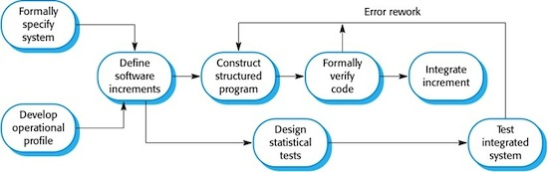
Cleanroom?
Here’s the cleanroom process:
Some cleanroom organizations pride themselves in not coding anything until they can prove the design is perfect.
Opposite of agile?
Notes:
Image from http://ifs.host.cs.st-andrews.ac.uk/Books/SE9/Web/Cleanroom/

